Slide 1
Bisection Method
(Midpoint Method for Equations)
Bisection Method = a numerical method in Mathematics to find a root of a given function
Root of a function f(x) = a value a such that:
f(a) = 0

Slide 2
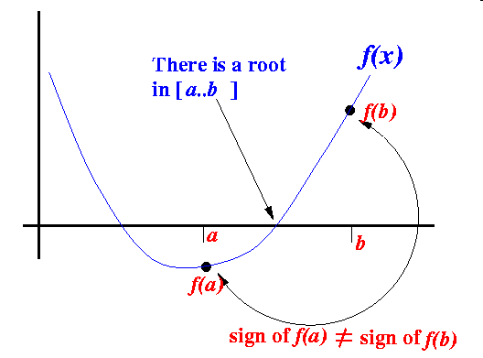
If a function f(x) is continuous on the interval [a..b] and sign of f(a) ≠ sign of f(b), then

Slide 3
The Bisection Method
The Bisection Method is a successive approximation method that narrows down an interval that contains a root of the function f(x)
The Bisection Method is given an initial interval [a..b] that contains a root (We can use the property sign of f(a) ≠ sign of f(b) to find such an initial interval)
The Bisection Method will cut the interval into 2 halves and check which half interval contains a root of the function
The Bisection Method will keep cut the interval in halves until the resulting interval is extremely small
The root is then approximately equal to any value in the final (very small) interval.

Slide 4
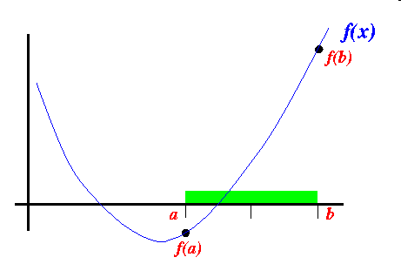
The Bisection Method (cont.)
Example:
Suppose the interval [a..b] is as follows:

Slide 5
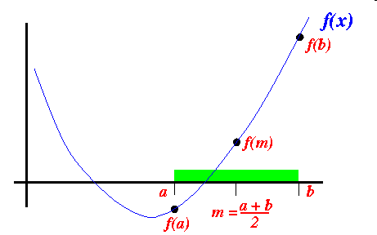
The Bisection Method (cont.)
We cut the interval [a..b] in the middle: m = (a+b)/2

Slide 6
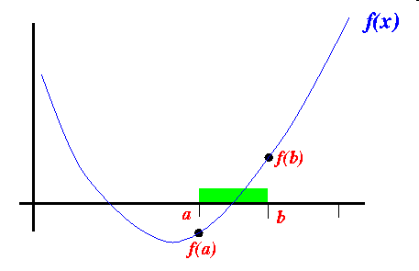
The Bisection Method (cont.)
Because sign of f(m) ≠ sign of f(a) , we proceed with the search in the new interval [a..b]:

Slide 7
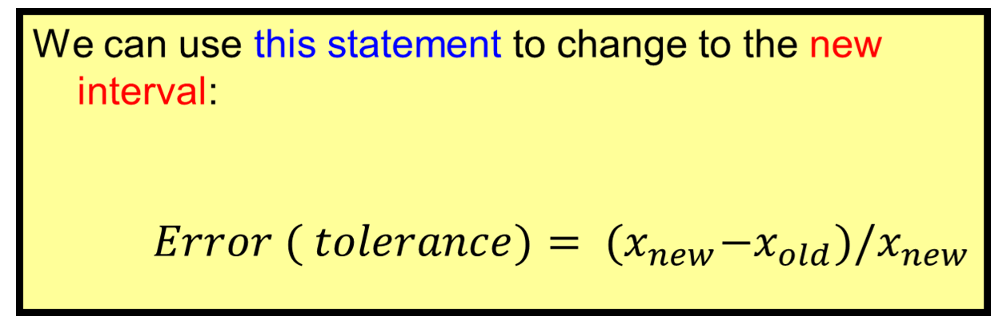
The Bisection Method (cont.)
b = m;

Slide 8
Bisection Algorithm
The idea for the Bisection Algorithm is to cut the interval [a,b] you are given in half (bisect it) on each iteration by computing the midpoint x_{mid}. The midpoint will replace either a or b depending on if the sign of f(x_{mid}) agrees with f(a) or f(b).
Step 1: input low limit (a), the upper limit (b) and tolerance
Step 2: Compute x_{mid} = (a+b)/2,
Step 3: If b-a < tolerance then end algorithm
else If (f(x_{mid})) * (f(a)) >0 then a = x_{mid}
else b = x_{mid}
Step 4: Return to step 2
f(a)
f(x)
root
x_{mid}
This shows how the points a, b and x_{mid} are related.
a
b
f(b)

Slide 9
Lets apply the Bisection Method to the same function as we did for the Regula-Falsi Method. The equation is: x³-2x-3=0, the function is: f(x)=x³-2x-3.
This function has a root on the interval [0,2]
Iteration | a | b | x_{mid} | f(a) | f(b) | f(x_{mid})
1 | 0 | 2 | 1 | -3 | 1 | -4
2 | 1 | 2 | 1.5 | -4 | 1 | -2.262
3 | 1.5 | 2 | 1.75 | -2.262 | 1 | -1.140
4 | 1.75 | 2 | 1.875 | -1.140 | 1 | -.158

Slide 10
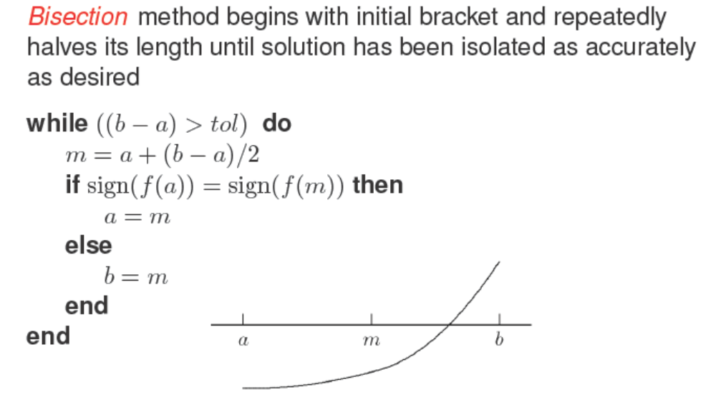

Slide 11
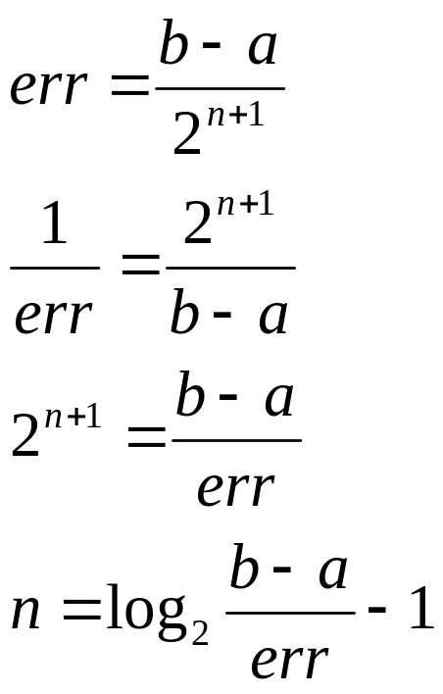
As we mentioned earlier we mentioned that we could compute exactly how many iterations we would need for a given amount of error.
The error is usually measured by looking at the width of the current interval you are considering (i.e. the distance between a and b). The width of the interval at each iteration can be found by dividing the width of the starting interval by 2 for each iteration. This is because each iteration cuts the interval in half. If we let the error we want to achieve err and n be the iterations we get the following:
This function has a root on the interval [0,2]

